Slide 1

WPDD202: Webpage Design & Development
Version 2 – 18th December 2015

Slide 2
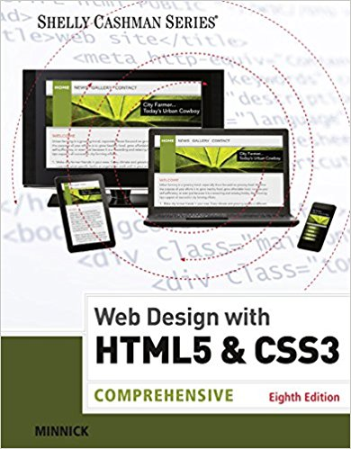
Resource Material
Web Design with HTML & CSS3: Comprehensive, 8th Edition
Jessica Minnick; Lisa Friedrichsen
ISBN-10: 1305578163 | ISBN-13: 9781305578166 © 2017
Cengage Learning Australia

Slide 3
Chapter 8
Creating Tables and Forms

Slide 4
Chapter Objectives
Define table elements
Describe the steps used to plan, design, and code a table
Create a table with rows and data
Insert a table caption
Style a table for tablet and desktop viewports
Describe form controls and their uses

Slide 5
Chapter Objectives (continued)
Use the form and input elements
Create text input controls, labels, and check boxes
Create a selection menu with multiple options
Use the textarea element
Create a Submit button
Create a Reset button

Slide 6
Discovering Tables
Tables
Compare data or outline a detailed topic in a compact format
Consist of rows, columns, and cells
Row – It is a horizontal line of information
Column – It is a vertical line of information

Slide 7
Discovering Tables (continued 1)
Cell
It is the intersection of a row and a column and usually contains data
The two types of cell are: a heading cell or a data cell
A heading cell displays text as bold and center-aligned
A data cell displays normal, left-aligned text and contains information appropriate for the column and row

Slide 8
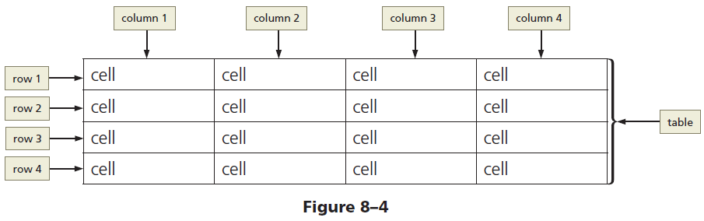
Discovering Tables (continued 2)
Figure 8–4 shows examples of the three elements: rows, columns, and cells

Slide 9
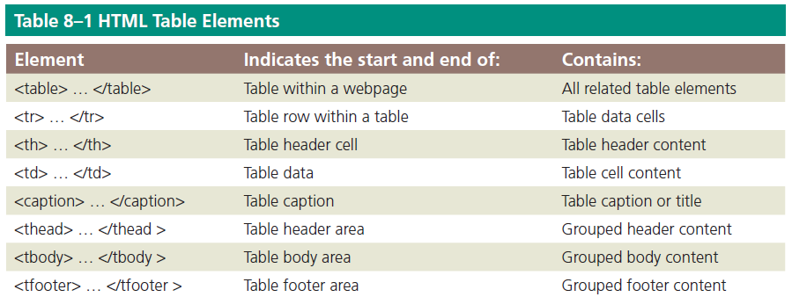
Creating a Table with HTML Elements
Table 8–1 lists the HTML elements used to create a table

Slide 10
Creating a Table with HTML Elements (continued)
Creating a table on a webpage
The <table> and </table> tags indicate the starting and ending of a table
The <tr> and </tr> tags indicate the starting and ending of each table row
The <td> and </td> tags indicate the starting and ending tags for data elements within the table row elements

Slide 11
Table Borders, Headers, and Captions
Table border – It is the line that defines the perimeter of the table
Table header
It is a heading cell and identifies the row or column content
It is defined with a starting <th> tag and an ending </th> tag

Slide 12
Table Borders, Headers, and Captions (continued 1)
Table caption
It is a descriptive text that serves as a title or identifies the table’s purpose
It is defined with a starting <caption> tag and an ending </caption> tag
It is inserted after the starting <table> tag
A table can have only one caption
Tables can include headers and captions individually or in combination

Slide 13
Table Borders, Headers, and Captions (continued 2)
Figure 8–6 shows a table created with the following code, which includes a table caption and table headers
<table>
<caption>College Course Recommendations by Semester</caption>
<tr>
<th>Semester 1</th>
<th>Semester 2</th>
<th>Semester 3</th>
<th>Semester 4</th>
</tr>

Slide 14
Table Borders, Headers, and Captions (continued 3)
<tr>
<td>English I</td>
<td>English II</td>
<td>Spanish I</td>
<td>Spanish II</td>
</tr>
<tr>
<td>College Algebra</td>
<td>College Geometry</td>
<td>Calculus</td>
<td>Trigonometry</td>
</tr>

Slide 15
Table Borders, Headers, and Captions (continued 4)
<tr>
<td>Physical Science</td>
<td>Biology</td>
<td>Humanities</td>
<td>World History</td>
</tr>
</table>

Slide 16
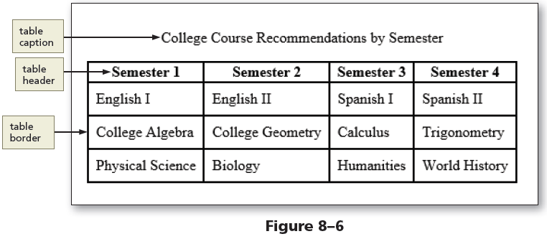
Table Borders, Headers, and Captions (continued 5)

Slide 17
Use of Tables
Tables
Display data in rows and columns
Should not be used to design a layout for a webpage
Help organize information so that it is easier for the user to read
Useful if the webpage needs to display a structured, organized list of information

Slide 18
Planning the Table
To create effective tables
Plan the information that will appear in columns and rows
Create a design that presents the information clearly
When planning a table for responsive web design, give careful consideration to the mobile viewport because of its screen size

Slide 19
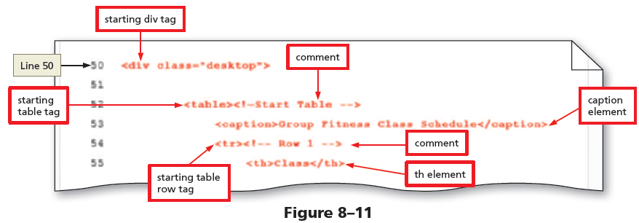
To Add a Table Element to the Classes Page

Slide 20
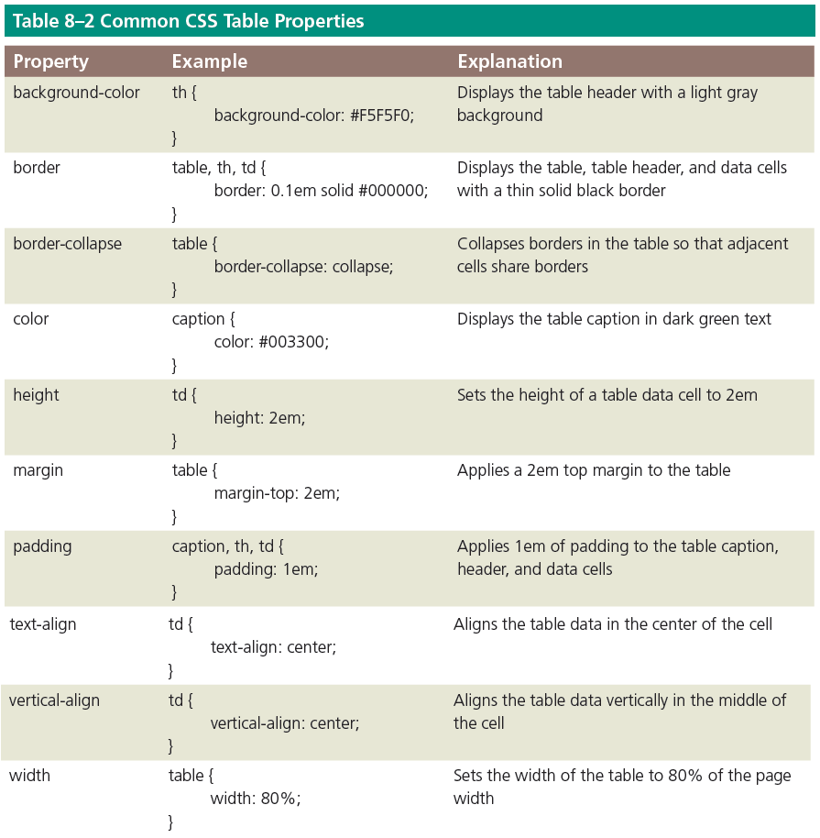
Styling Table Elements

Slide 21
Styling Table Elements (continued)
Separated border
When a border is applied to table elements, by default, each cell has its own border, making the table appear to use double lines between each table data cell
Collapsed border
Use the border-collapse property with a value of collapse to display a table with single, consolidated borders

Slide 22
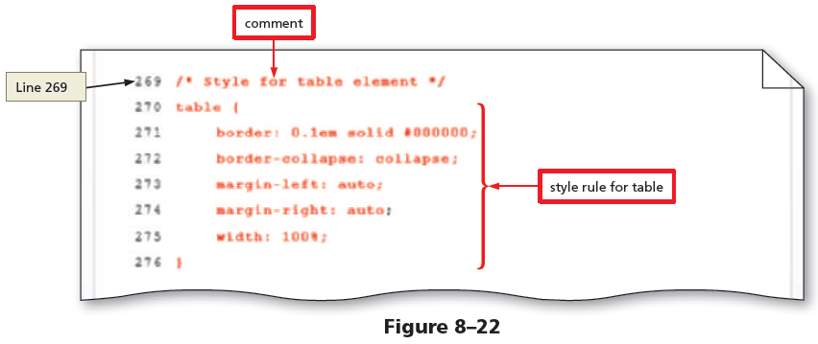
To Style a Table for a Tablet Viewport

Slide 23
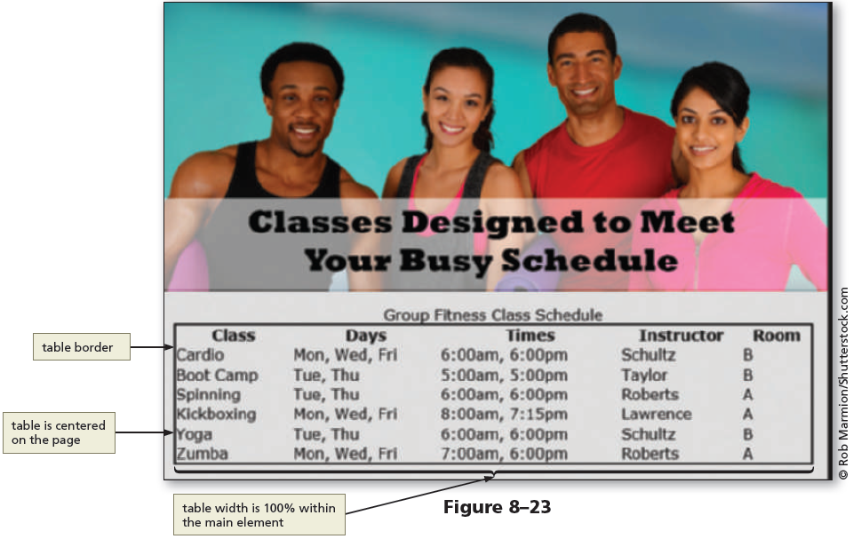
To Style a Table for a Tablet Viewport (continued 1)

Slide 24
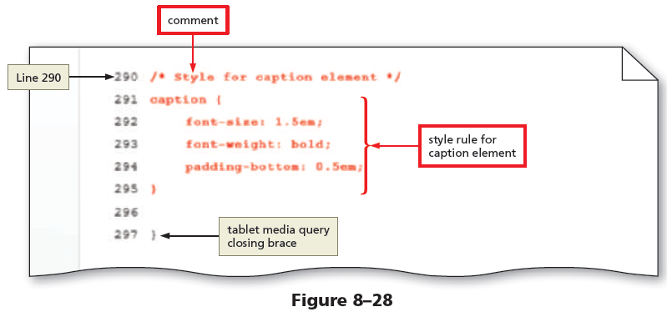
To Style a Table for a Tablet Viewport (continued 2)

Slide 25
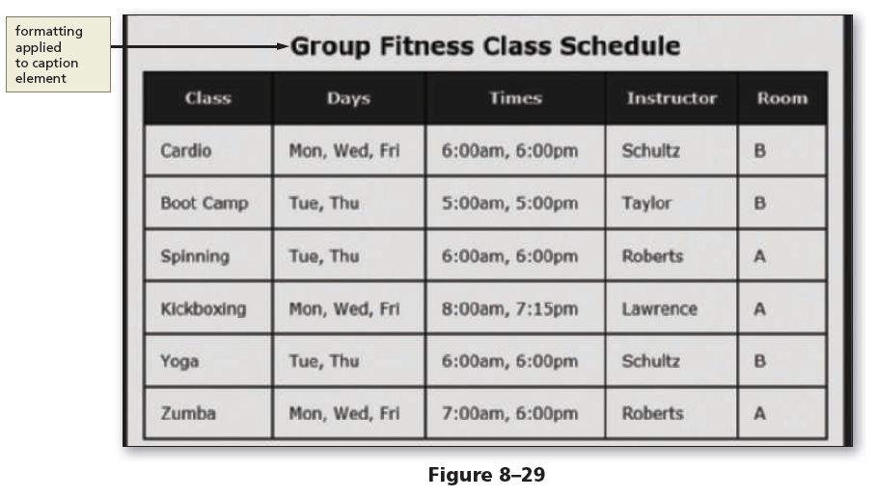
To Style a Table for a Tablet Viewport (continued 3)

Slide 26
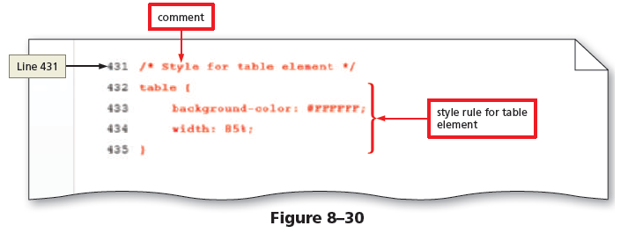
To Style a Table for a Desktop Viewport

Slide 27
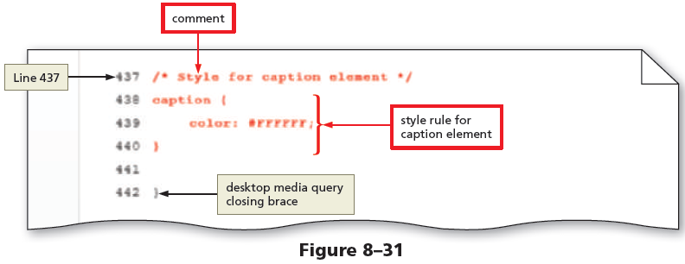
To Style a Table for a Desktop Viewport (continued 1)

Slide 28
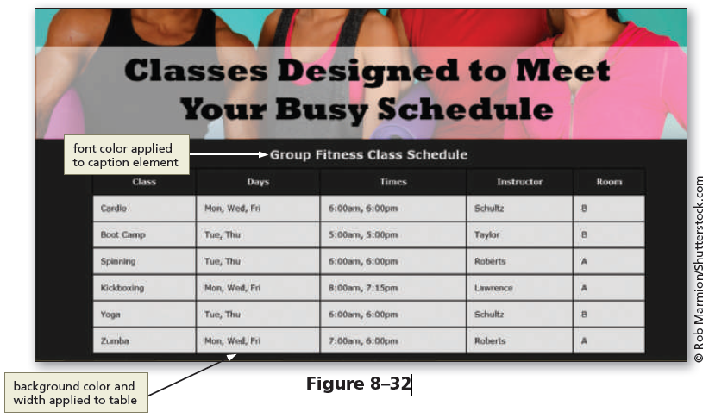
To Style a Table for a Desktop Viewport (continued 2)

Slide 29
Creating Webpage Forms
Forms provide a structured way to collect information from webpage visitors
Visitors complete webpage forms to register for an account or to make a purchase.
Businesses use forms to gather visitor or customer information and store it in a database for future use

Slide 30
Form Controls
All form elements are contained with the starting <form> tag and the ending </form> tag
Input control – It is an interactive mechanism for users to enter text or make selections on a form
A label is text describing the type of information to enter with an input control.
Most controls in an HTML form are defined by using the type attribute of the input element

Slide 31
Form Controls (continued 1)
Define other controls using separate elements, such as the textarea and select elements
The two input controls are:
Data input control – It is used to make a selection or perform a command
Text input control – It accepts text, such as names, dates, and passwords, and is called an input field

Slide 32
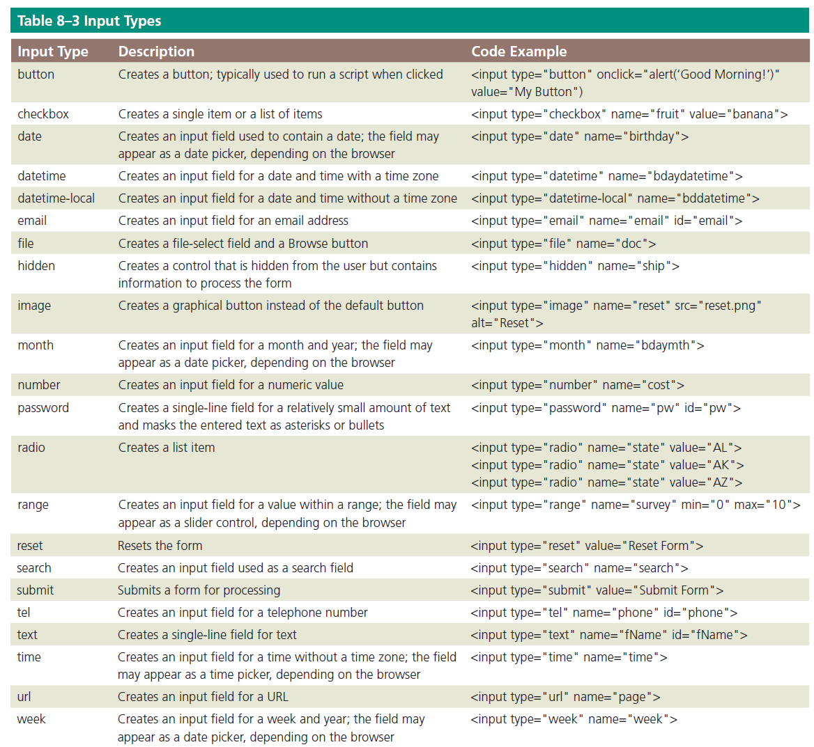
Form Controls (continued 2)

Slide 33
Form Controls (continued 3)
Each input control has attributes that are used more frequently than the others:
name – It identifies the specific information that is being sent when the form is submitted for processing. All controls have a name
id – It provides a unique ID for the element. Use the id attribute with input controls
value – It specifies the value of an input element and varies depending on input type

Slide 34
Form Controls (continued 4)
Common input controls used with a form include text, password, email, checkbox, select, submit, reset, etc.
Text input controls include the following types:
text box (text control), for small amounts of text
password text box (password control), for entering a password
email text box (email control), for entering an email address

Slide 35
Form Controls (continued 5)
telephone text box (tel control), for entering a telephone number
date text box (date control), for entering a date
text area box (textarea control), for larger amounts of text
These text input controls have two frequently used attributes:
size – It determines the width of the control in characters
maxlength – It specifies the maximum number of characters accepted

Slide 36
Form Controls (continued 6)
Example:
The first line of the following code creates a 25-character text box for the user’s last name and the second line creates an eight-character text box for the user’s password:
<p>Last Name: <input name="lastname” type="text” size="25">
</p>
<p>Password: <input name="password type="password" size="8">
</p>

Slide 37
Form Controls (continued 7)
Password control – It is a text control as it provides a text box for the password a visitor enters
Email control – It is a text box where visitors enter an email address
Tel control – It is a text box where visitors enter a telephone number
Date control – It is a text box that accepts a date

Slide 38
Form Controls (continued 8)
Textarea control – It creates a text box that allows multiple lines of input
To create a textarea control, use the textarea element instead of the input element
It has two primary attributes, which set the size of the textarea control:
rows, which specifies the number of rows, or lines, in the textarea control
cols, which sets the width of the textarea control as the number of columns, with each column containing one character

Slide 39
Form Controls (continued 9)
The following is an example of HTML code defining a textarea control:
<label>What products would you like to see us offer?
</label>
<textarea name="feedback" rows="3" cols="100">
</textarea>

Slide 40
Form Controls (continued 10)
Checkbox control
It allows a webpage visitor to select items from a list of one or more choices
The following code is an example for two checkbox controls that might appear on a form for a grocery store website
<input name="fruit" type="checkbox" value="apple“ checked="checked">Apple
<input name="fruit" type="checkbox" value="peach">Peach

Slide 41
Form Controls (continued 11)
Radio control
It limits the webpage visitor to only one choice from a list of choices
Each choice has a radio button, or option button, which appears as an open circle
By default, all radio buttons are deselected
To set a particular button as the default, use the checked attribute and value within the <input> tag

Slide 42
Form Controls (continued 12)
The following is sample code to create two radio controls that might appear in a rental car website form:
<input name="car" type="radio" checked="checked" value="car">Car
<input name="truck" type="radio" value="truck">Truck
A visitor can choose to rent a car or a truck, with the Car radio button already selected when the form opens

Slide 43
Form Controls (continued 13)
Select control
It creates a selection menu from which the visitor makes one or more choices and is suitable when a limited number of choices are available
It appears on a form as a text box with a list arrow
The following is sample code for a select control:
<select name=“station”
<option>Pandora</option>
<option>Internet Radio</option>
<option>Live365</option>
<option>Jango</option>
</select>

Slide 44
Form Controls (continued 14)
Submit button
It sends the form information to the appropriate location for processing
When it is clicked on the form, the name of each control and the value of its data are sent to the server to be processed
The submit control is created with the following code:
<input type=“submit” value=“Submit”>

Slide 45
Form Controls (continued 15)
Reset button
Clears any input entered in the form, resetting the input controls to their defaults
A webpage form must include a submit control and a reset control
The value attribute specifies the text that appears on the button
The reset control is created with the following code:
<input type="reset" value="Reset">

Slide 46
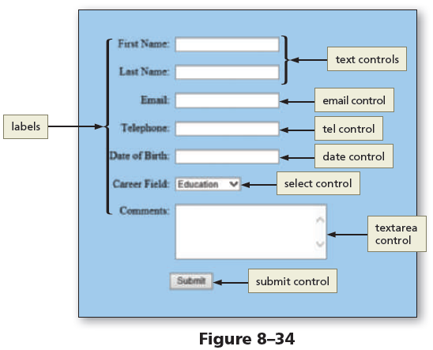
Form Controls (continued 16)
Figure 8–34 shows an example of a form with several input controls, including text, email, tel, date, select, and textarea

Slide 47
Form Controls (continued 17)
Form Labels
They identify the type of information to enter into or select from an input control
They are added to a form using the label element
To connect them to their controls, include the for attribute with the same value as the input control’s id value

Slide 48
Form Controls (continued 18)
The following code creates a label and a text box for a visitor’s first name:
<label for="fName">First Name:</label>
<input type="text" name="fName“ id="fName">

Slide 49
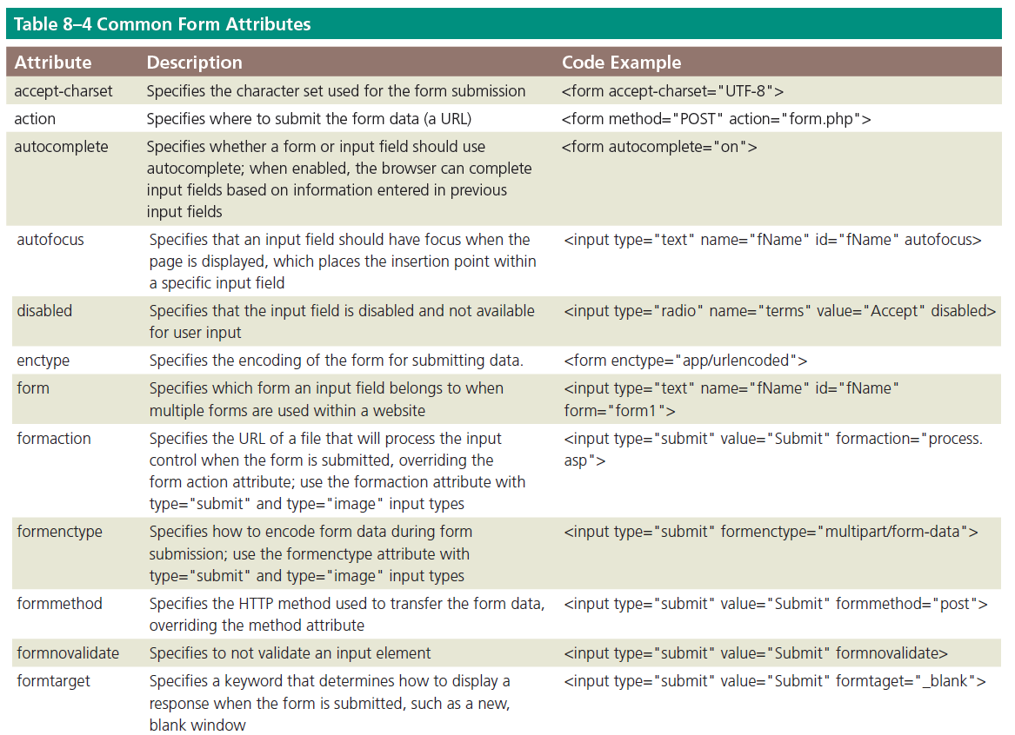
Form Controls (continued 19)

Slide 50
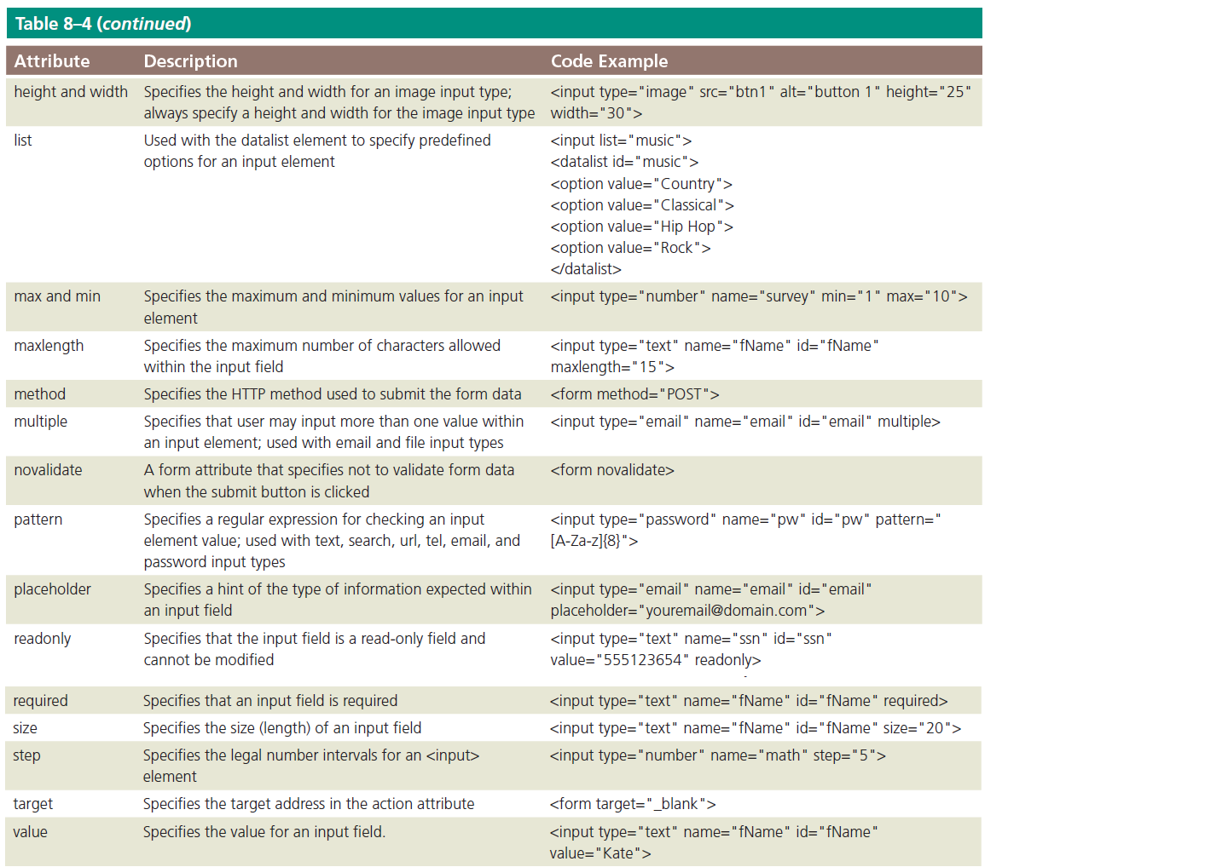
Form Controls (continued 20)

Slide 51
Form Processing
action
It is an attribute of the <form> tag that specifies the browser’s action when submitting the form
Common Gateway Interface (CGI) script
It communicates with the web server and sends the information on the webpage form to the server for processing

Slide 52
Form Processing (continued 1)
method
It is an attribute of the <form> tag that specifies how to send the data entered in the form to the server to be processed
Get method
It appends the name-value pairs to the URL indicated in the action attribute
Example of a form tag with the get method and specified action is as follows:
<form method=“GET” action=“formInfo.php”>

Slide 53
Form Processing (continued 2)
Post method
It sends a separate data file with the name-value pairs to the URL indicated in the action attribute
It is used very commonly because it can be used to send sensitive form data and does not have a size limitation
Example of a form tag with the post method and specified action is as follows:
<form method=“POST” action=“formInfo.php”>

Slide 54
Styling Forms
CSS styles are applied to forms to improve the appeal and usefulness of the form and its controls
As with tables, consider forms in the context of responsive design
Controls can be included to collect optional information, such as product feedback, in tablet and desktop viewports

Slide 55
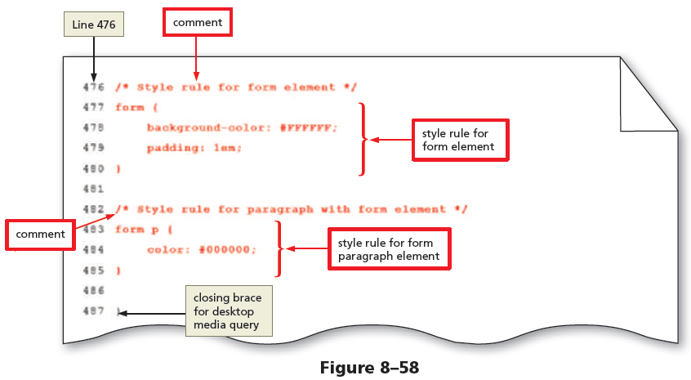
To Style a Form for a Desktop Viewport

Slide 56
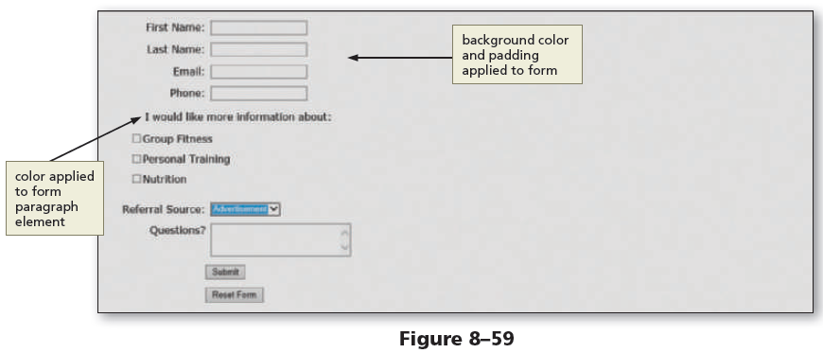
To Style a Form for a Desktop Viewport (continued)

Slide 57

kent.edu.au Kent Institute Australia Pty. Ltd. ABN 49 003 577 302 ● CRICOS Code: 00161E ● RTO Code: 90458 ● TEQSA Provider Number: PRV12051

